Slide 1

2014-2015 NBA SEASON ANALYSIS
Arjun Adapalli
Aishwarya Srikanth
Corey Haines
Jushira Thelakkat
Reed Dalton
Notes:
Hello Group 9,

Slide 2
What are the overall trends in the 2014-2015 NBA season?

Slide 3
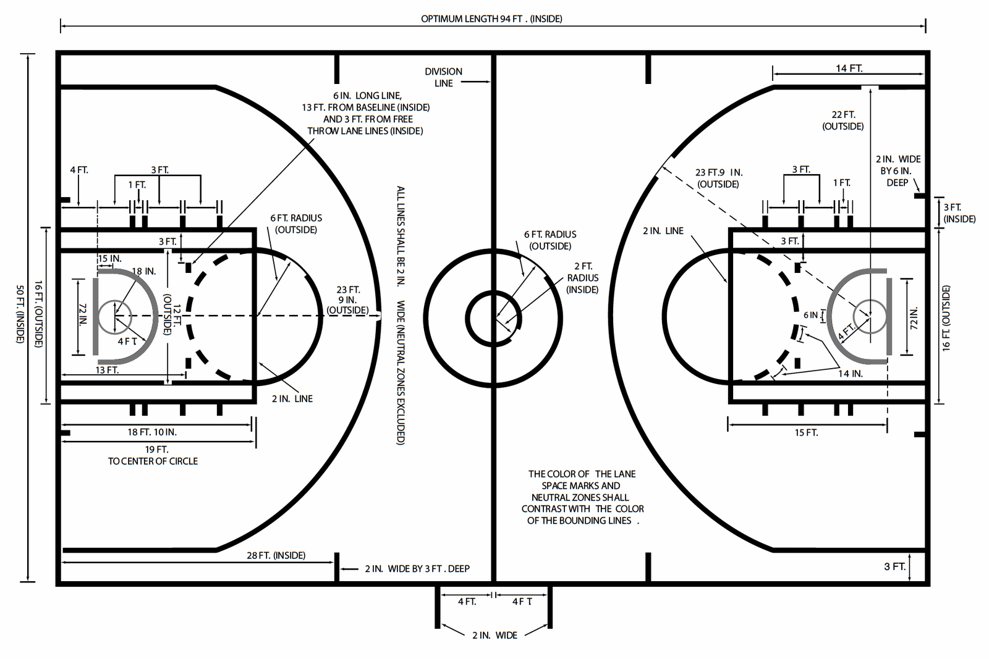
NBA Court Layout
Notes:
Corey

Slide 4
Home Court Advantage
Notes:
Thank You Corey.
We took this dataset from Kaggle.com. It has 128k rows, each row referring to a shot attempt by a player. And we have 22 columns, each referring to an attribute such as the game id, date and month, player and defender names, pts type (2 or 3) and so on.We did a lot of data cleaning before getting to our analysis and after the exploratory analysis, we aim to predict shot outcomes.. In order to build a flow in our analysis, we split the EDA into team based analysis, league based analysis and player based where we studied the performance of few important players of that season. In team based, we looked at the basic Home advantage area.

Slide 5
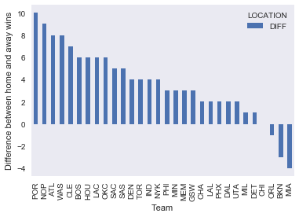
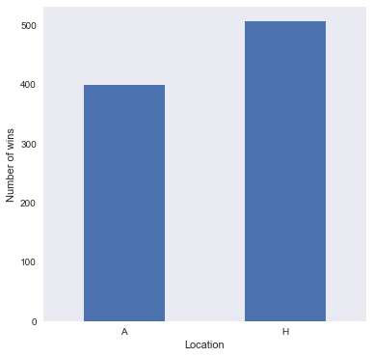
Total Win Shares
Win Shares by Team
Notes:
Jushira
We looked at the total number of home and away wins, seeing that around 56% wins were home wins. We then split the home and away wins by team. And saw that out of the 30 teams that we had, 26 had won more games at home while 3 won more at away locations and 1 had won equal in both. So we see that clearly, teams in the 2014-15 season had a home advantage, which we would expect.

Slide 6
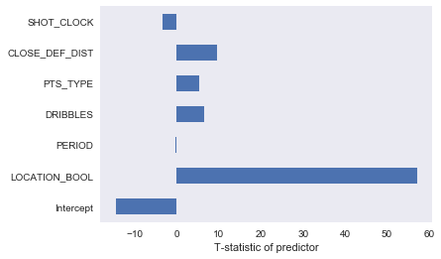
Increasing Margins
Correlation of Predictors
Using Linear Regression to identify variables correlated to the Margin of Victory Predictor with the highest correlation to the Margin of Victory: Location Home Court Advantage is Real!
(2.26 points)
Notes:
Aishwarya -
Linear regression analysis shows that playing at home gives teams on average additional 2.26 margin points(coefficient)
Research also shows a recent trend of decline in home advantage over the years: probability of a home team winning has reduced from around 65% in 1975-1992 to average of 60.3% in 1993-2011 and to around 58.5% for 2011-14. The analysis demonstrated that the home win ratio went down even further to 56.0% in 2014-2015 season. Based on the literature review this trend could be potentially explained by the following factors (Economist, 2015):
Improvement of travel conditions This means that when playing away, teams are now more likely to stay at better hotels and fly chartered planes more often than in the past. These changes result in teams being less tired as a consequence of travel and being better physically prepared for the games.
Change in style of play in NBA The game now is more open with less physical contact, which reduces number of fouls and potential impact of 'notorious home-team bias' by referees

Slide 7
Effect of Rest on Performance

Slide 8
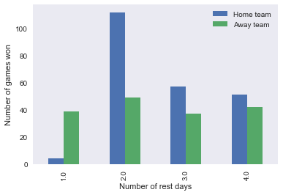
Fading Stars: Can More Rest Boost Wins?
Notes:
Aishwarya -
The objective was to observe whether the amount of rest that a team gets between games is related to their performance. From Plot 4, we see that most of the games are covered within 5 rest days, hence the focus of our analysis on this subset. From Plot 5, we see that home teams' performance increases as they have more rest, but only up to 2 rest days. After this, players can fall out of rhythm and rest can become costly. Rest days have little effect on the win share of the away teams.

Slide 9
Can Teams Take More Efficient Shots?

Slide 10
The Rise of “MoreyBall’
Notes:
Reed

Slide 11
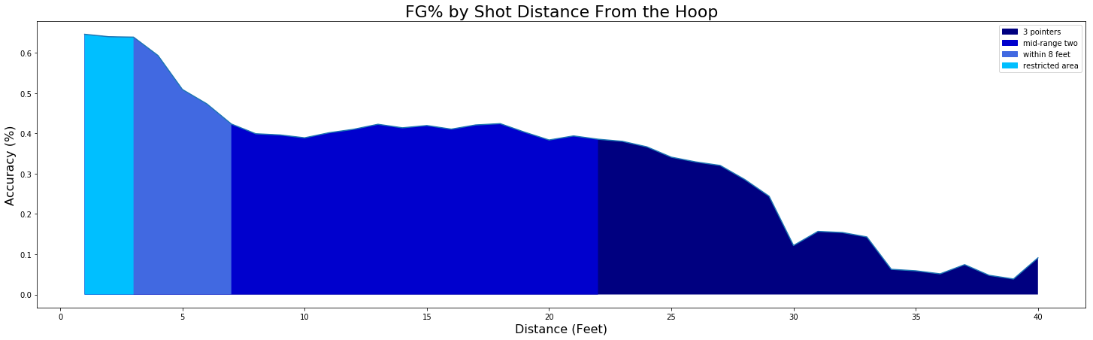
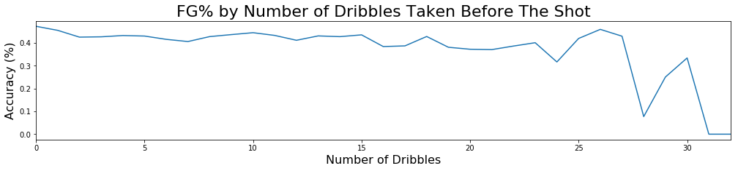
Notes:
Reed

Slide 12
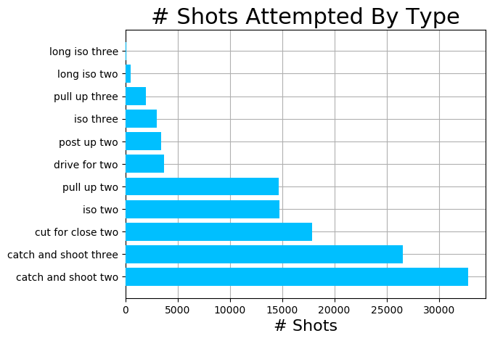
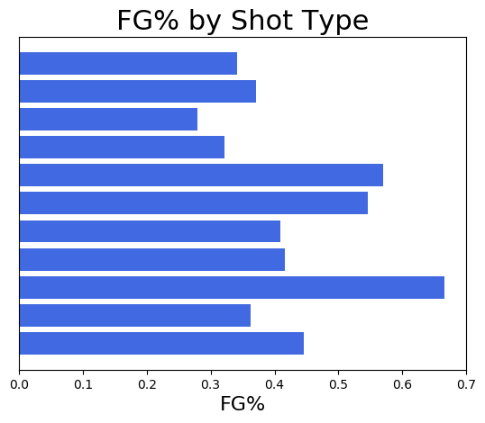
Shot Makeup of the 14-15 Season
Notes:
Reed

Slide 13
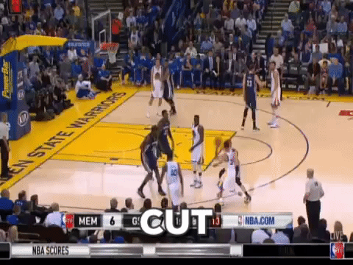
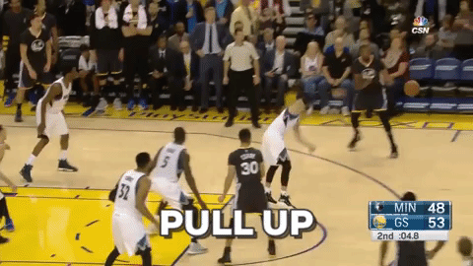
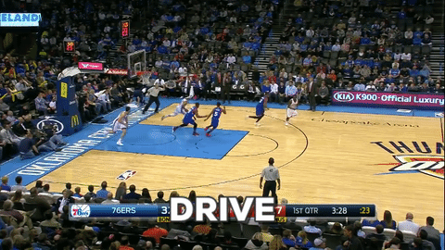
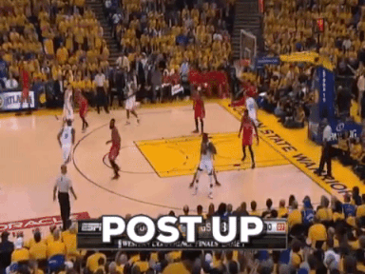
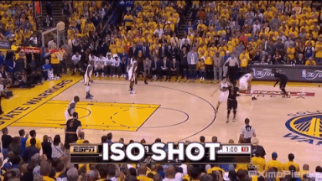
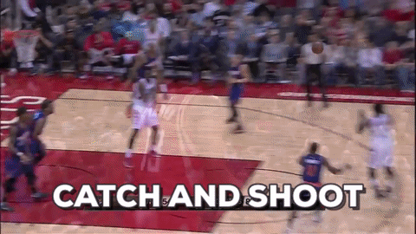
Notes:
Reed

Slide 14
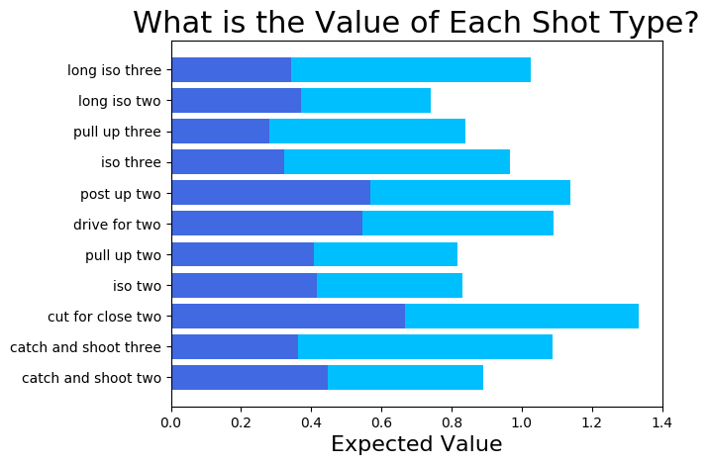
Increasing Your Shot
Most Value in finishing at the rim/quick release threes
Not enough attempts for top three types
Notes:
Reed

Slide 15
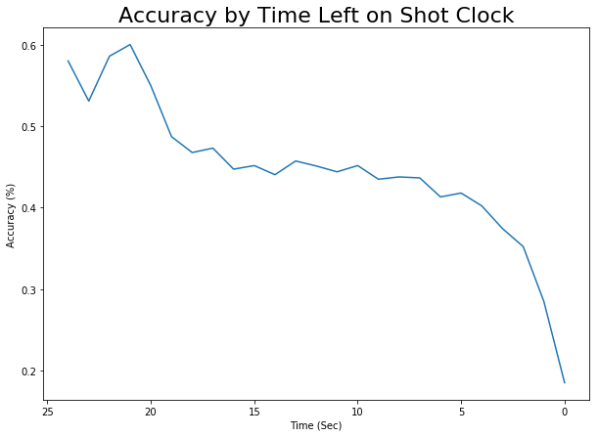
Do Players Notice the Shot Clock?
Shots in the last five seconds are tough
Notes:
Arjun
Earlier we looked at accuracy based on shot distance. We also looked at whether the time left on the shot clock had an effect on shot accuracy. We created this plot, and what we found was that there was a gradual decrease from 19 to 5 seconds, followed by a steep drop from 5 seconds onwards. This sudden drop in accuracy makes sense because there’s more pressure on the player as the shot clock nears 0.
The relatively high accuracy rates at 20 seconds and above may be attributed primarily to shots made after offensive rebounds, or rebounds made by the same team after a missed shot. In such cases, the shot clock resets after the ball hits the backboard, and these shots are relatively easier to make since the players are closer to the net.

Slide 16
Superstars in the NBA
Notes:
After looking across all players, we then decided to focus our attention on the top 4 MVP’s of the season: LeBron James, Steph Curry, Russell Westbrook and James Harden.

Slide 17
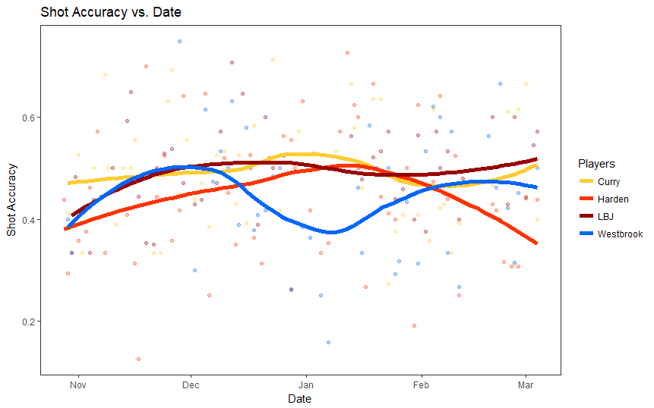
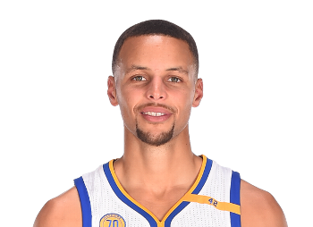
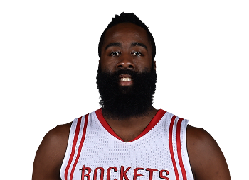

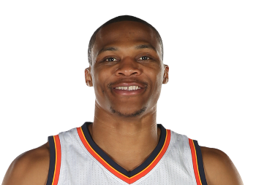
Do Superstars Slump?
Notes:
Arjun
We first looked at the shot accuracy of the 4 players over time, from the end of October to early March.
As you can see, the players maintained shot accuracies within the range of roughly 3.8 to 5.1.
Curry and James had relatively stable shot accuracy throughout most of the timeline, while the accuracy of Harden and Westbrook had greater variance.
James started with a lower accuracy, but quickly improved after the 1st month.
Westbrook tends to make more shots at the end of the season, during which time Oklahoma City Thunder is fighting for the last playoff position.

Slide 18
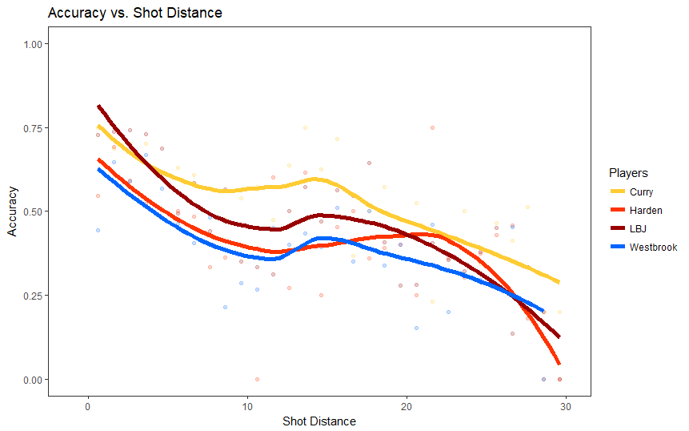
Can Superstars Score From Anywhere?
Notes:
Aishwarya
The shot accuracy decreases from the lay-up region to around 10 feet. For Curry, James and Westbrook, although value of accuracy differ with each other, they all have a local maximum at around 14 feet. Let's call this region the comfortable zone. On the other hand, the accuracy peak of Harden extends out of the three-point line, which is different with the others. When the comfortable zone is passed, the accuracy for all players decreases monotonically.

Slide 19
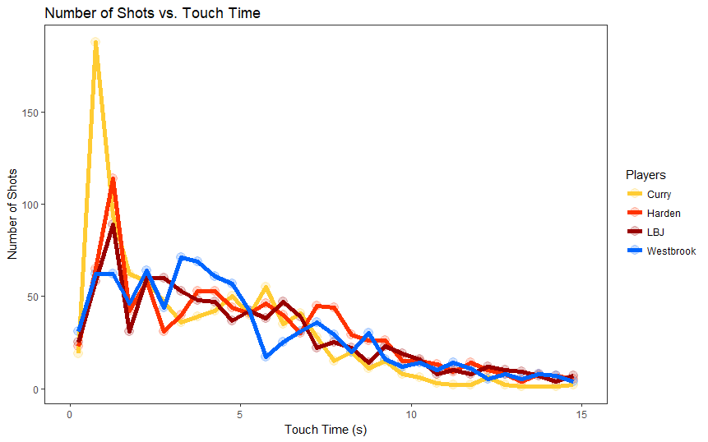
Do Superstars Take Their Time to Shoot?
Notes:
Arjun
This graph shows the number of shots each player took as a function of how long they held the ball before taking the shot. Curry performed relatively more shots at a very short touch time, indicating his catch-and-release shooting style. Westbrook, on the other hand, tended to take more time before taking his shot.

Slide 20
Do NBA Superstars get Hot Hands?
Notes:
Jushira
Continuing the discussion of these four players, wanted to test the Hot Hand phenomenon on them.
Hot hand in basketball is basically the claim that after a shot is made, the players have better chance at scoring the next shot i.e their accuracy rates are higher after a shot is made.
This would probably be interestig to know if a ball should be passed to such a player who has made a shot.

Slide 21
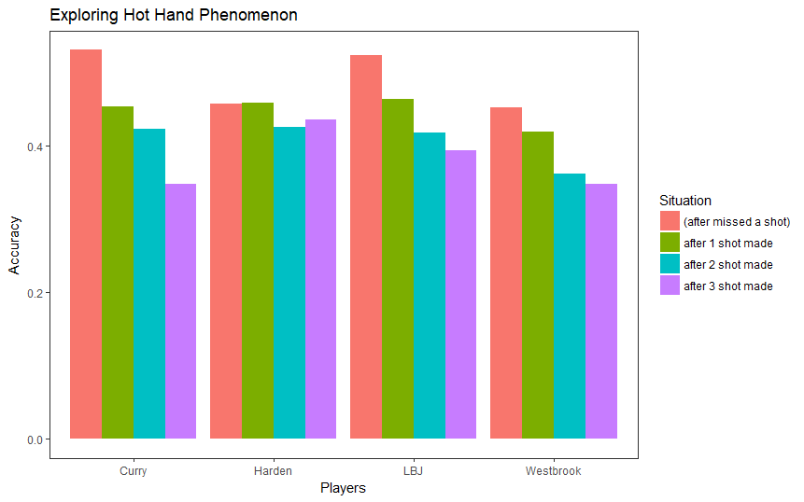
Hot Hand Phenomenon
Notes:
Jushira For each player, the left most red bar represents the shot accuracy of all shots right after missing one shot. The green, blue, and purple bars represent the shot accuracy after making 1, 2 and 3 consecutive shots. Expected a left skewed?. But we got just the opposite for three of the top four. Harden showed a relatively stable accuracy rate. While for other three, making a shot actually reduced the accuracy of making the next shots.

Slide 22
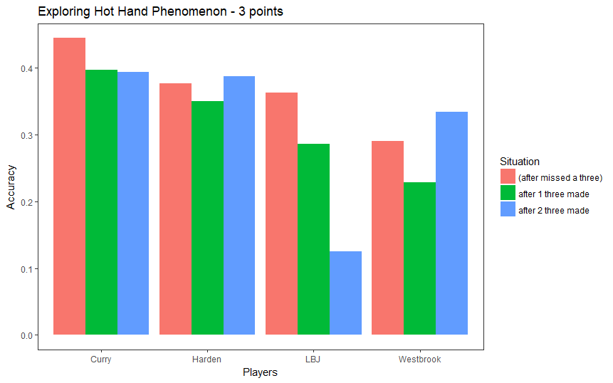
Hot Hand Phenomenon - 3 Points
Notes:
Jushira curry and lebron
No hot hands! - Could be because- a "hot" player cools off because opposing players start to guard him more aggressively, or because he gets over-confident and starts taking tougher shots from further behind the three point line

Slide 23
Predicting Shot Outcomes
Notes:
Corey

Slide 24







Splitting the Data
Random Forest Models
30%
70%
40%
60%
50%
50%
60%
40%
70%
30%
Training Data
Test Data

Slide 25
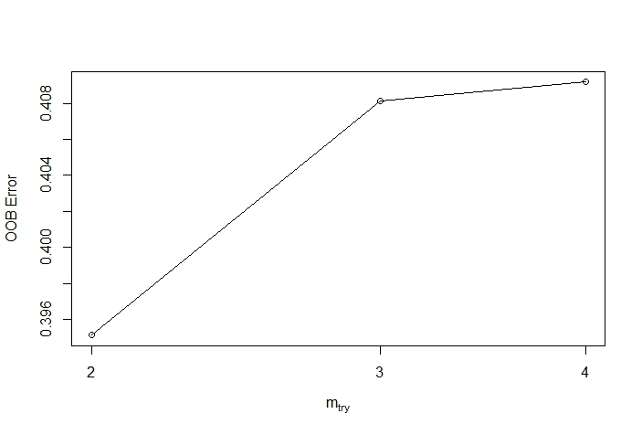
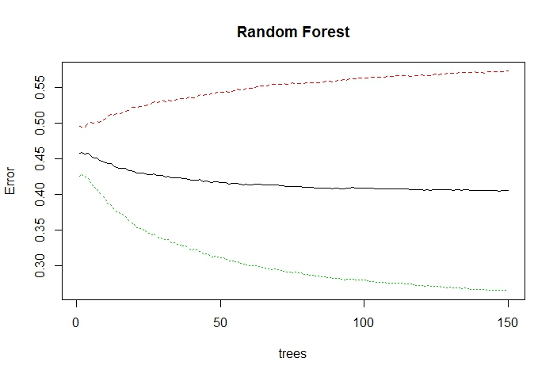
Parameter Tuning
Set n = 100
Set mtry = 2

Slide 26
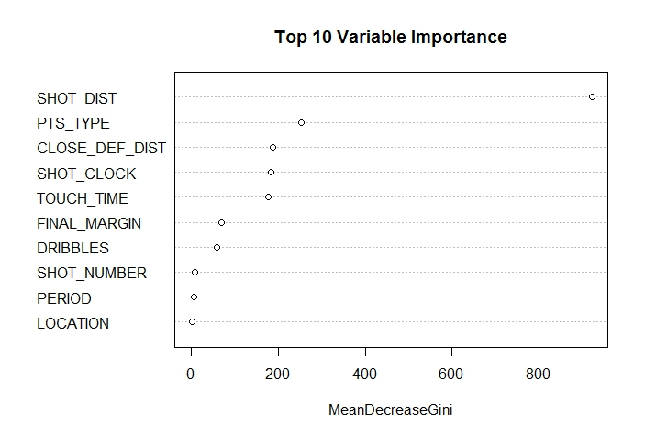
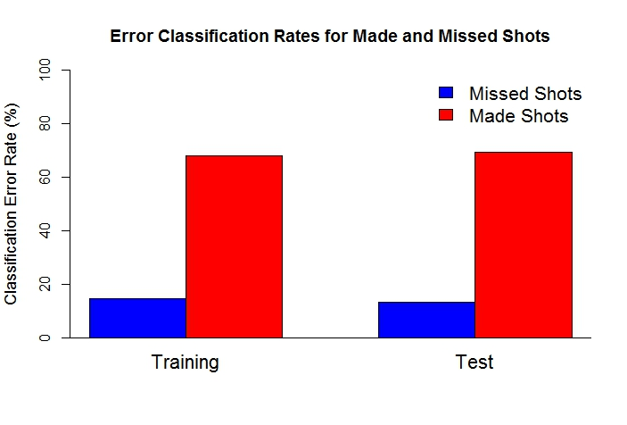
Model Performance

Slide 27
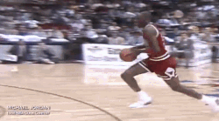
Presentation Slam Dunk
Incorporate Defender Data
Try Different Models
Use Full Dataset

Slide 28
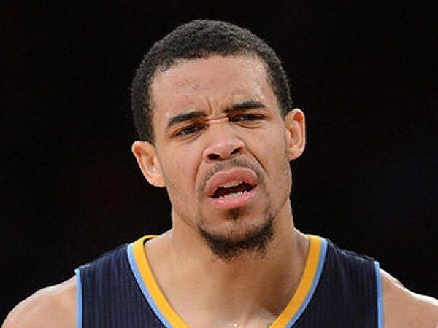
Questions?

Slide 29

Thanks for Listening!

